Slide 1
glTF 2.0 Renderer – WebGPU (GLSL + gl-Transform)
Live Demo (Use Chrome/Edge Canary): https://gltf-webgpu.netlify.app/
(Charles) Zixin Zhang
https://github.com/zixin96/gltf-webgpu-viewer

Slide 2
Motivation
Live Demo (Use Chrome/Edge Canary): https://gltf-webgpu.netlify.app/
Explore a new, low-level Graphics API (WebGPU) and a fast, efficient 3D transmission format (glTF 2.0)
Contribute to glTF and WebGPU’s open-source community
Create a fun, challenging, and rewarding project

Slide 3
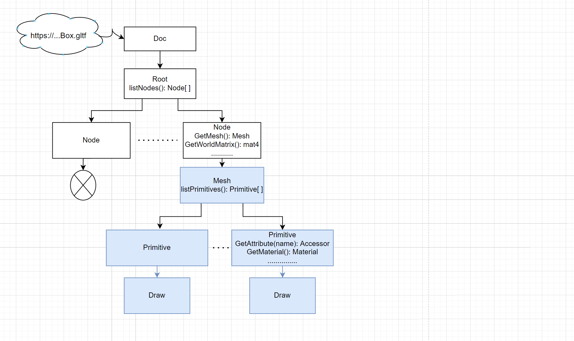
Architecture
Live Demo (Use Chrome/Edge Canary): https://gltf-webgpu.netlify.app/
1. Request https:// glTF files
2. Select nodes with meshes
3. Retrieve data (texture, vertex
attributes, etc.) and draw via
WebGPU pipelines

Slide 4
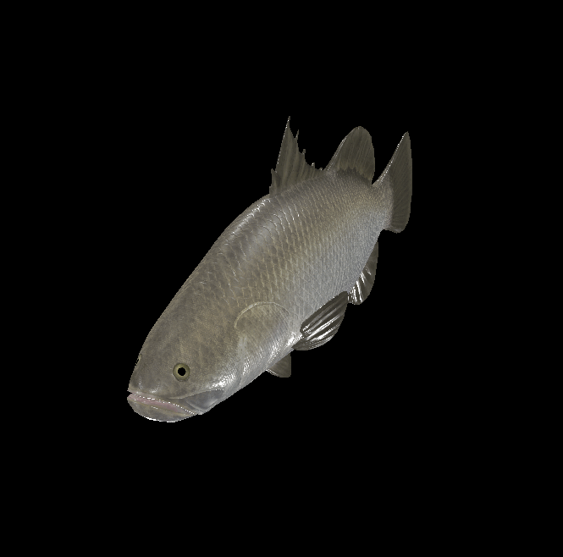
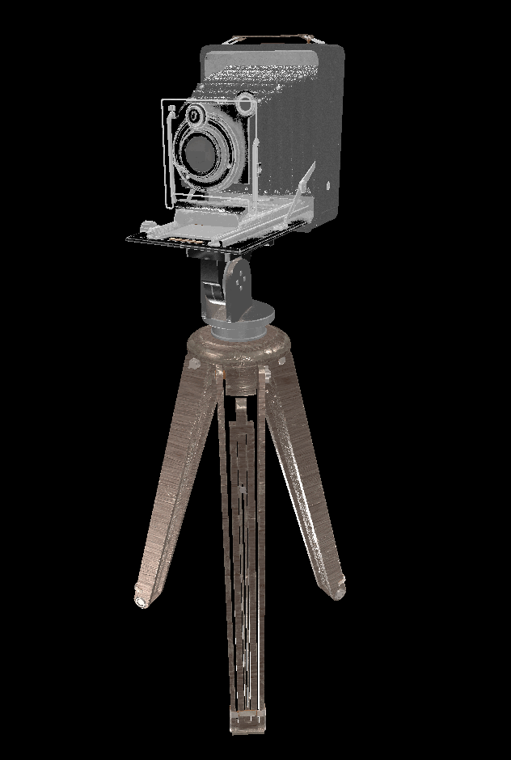
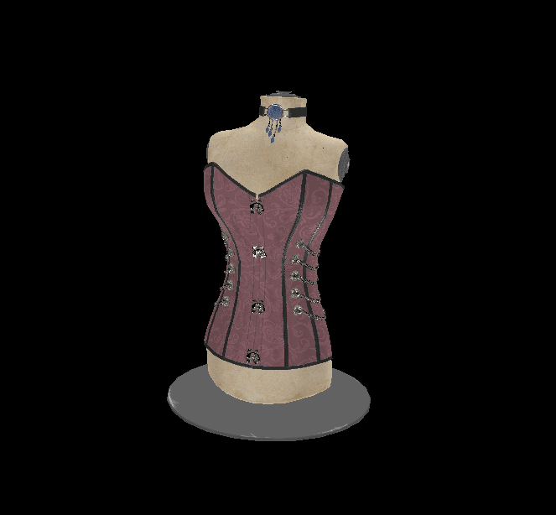
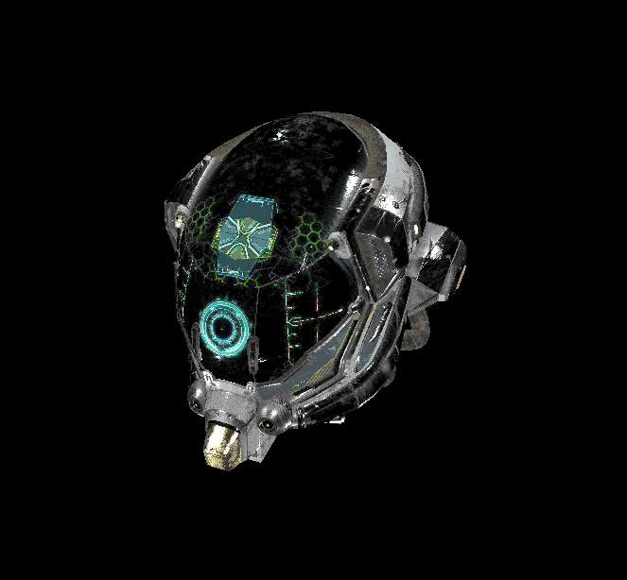
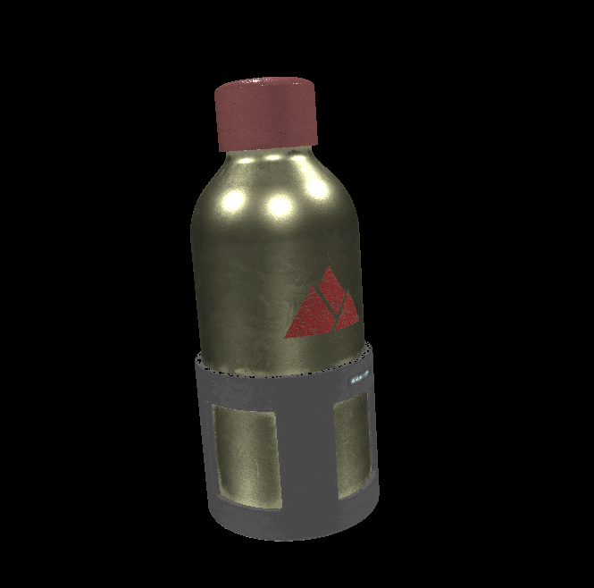

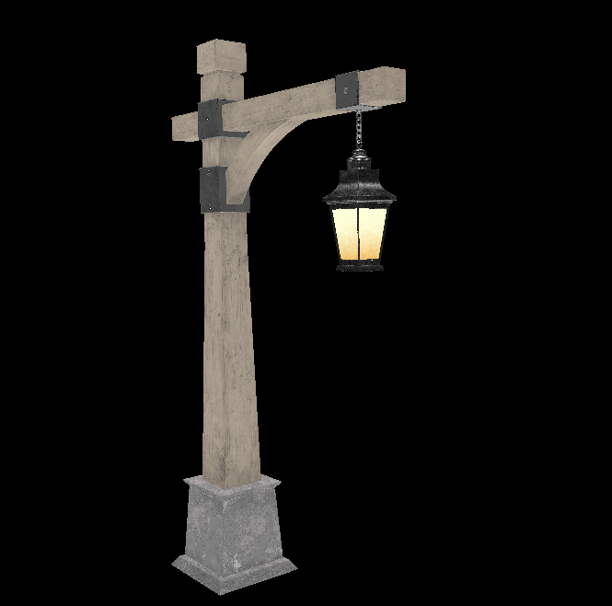
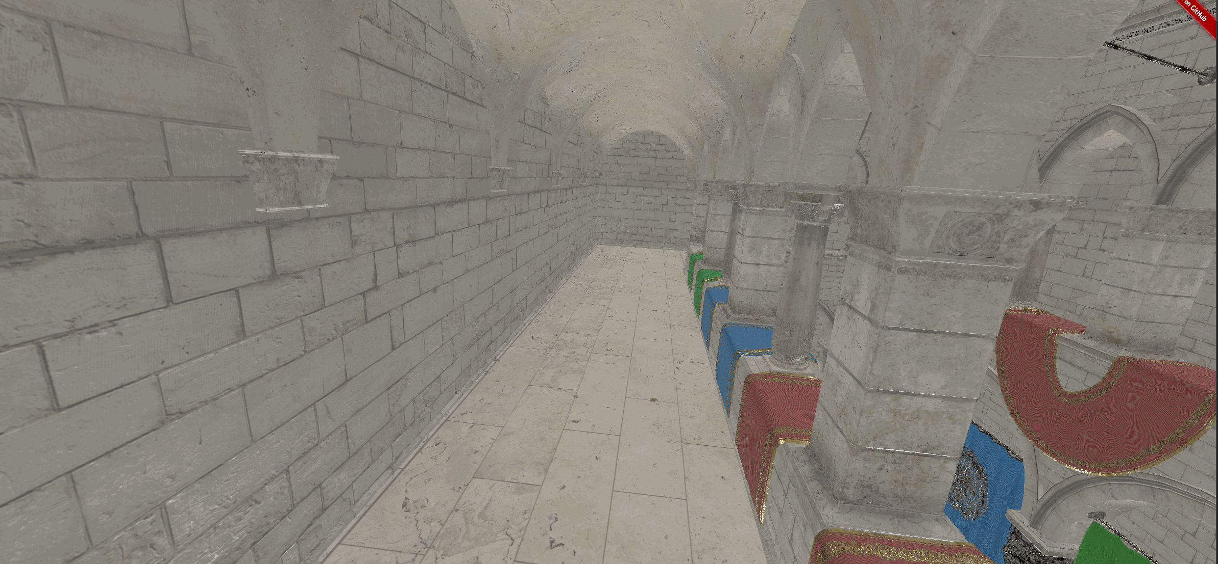

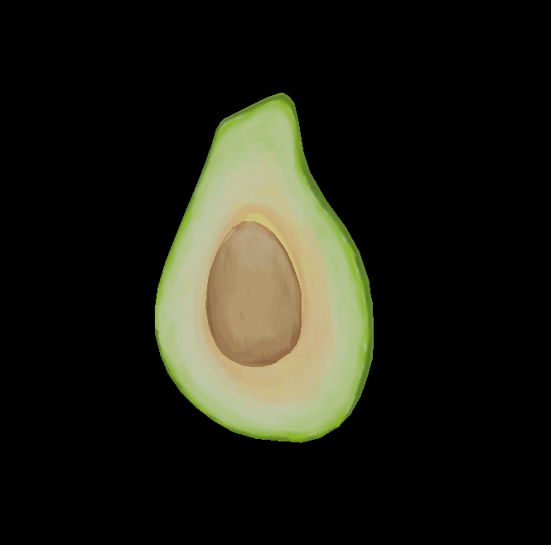
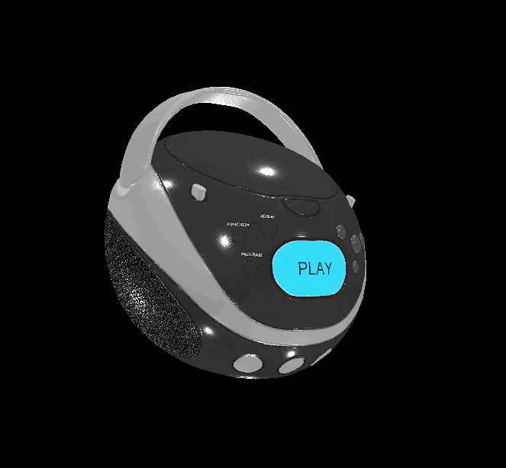
Supported Features/Models
Live Demo (Use Chrome/Edge Canary): https://gltf-webgpu.netlify.app/
Core glTF 2.0 Sample Models
Standard glTF 2.0 Sample Models (except for animation and skin)
Extensions: KHR_lights_punctual
Selected Demo:

Slide 5
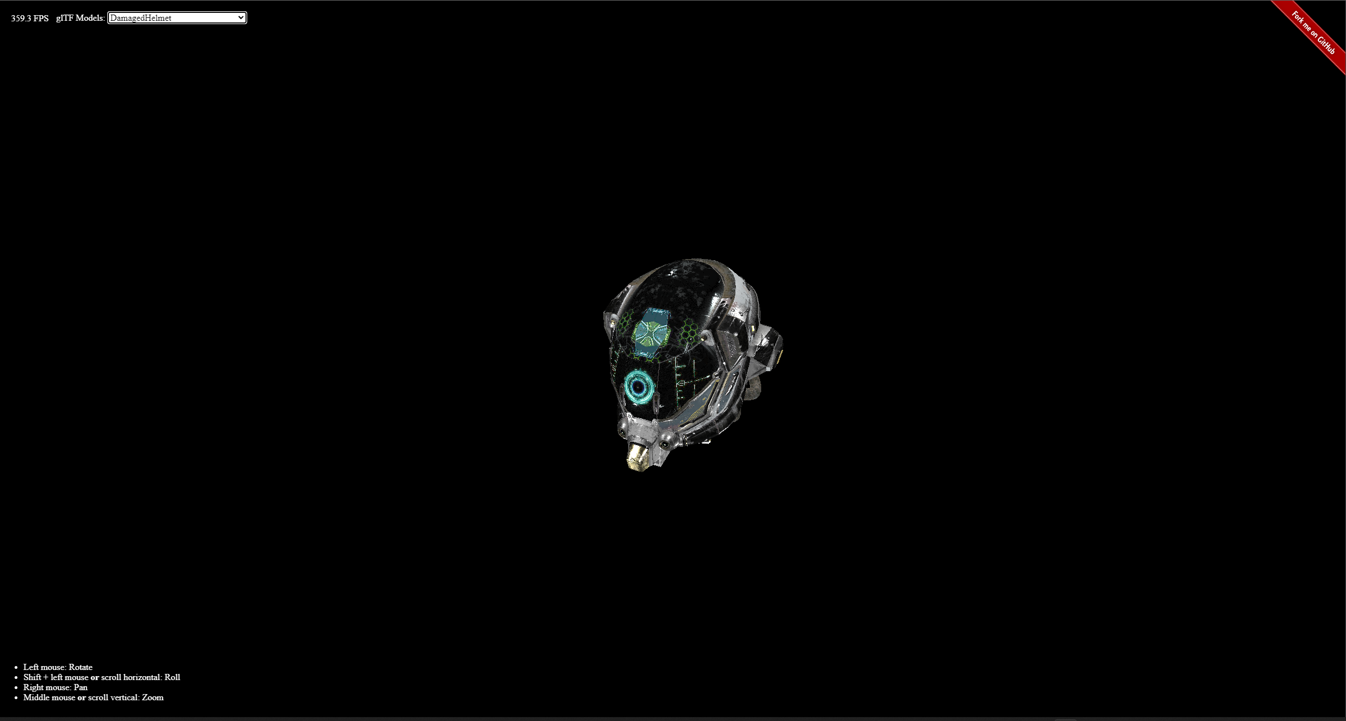
Live Demo (Use Chrome/Edge Canary): https://gltf-webgpu.netlify.app/
Live Demo

Slide 6
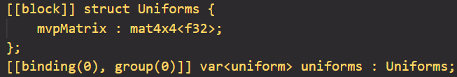
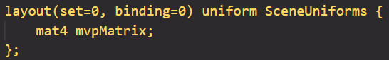
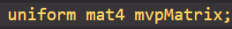
Why GLSL?
Live Demo (Use Chrome/Edge Canary): https://gltf-webgpu.netlify.app/
GLSL is less verbose than WGSL, but offers programmers more control over GLSL (WebGL)
If future support for WGSL is needed, the manual conversion
between WGSL and GLSL is doable
Use the same concepts like sets/groups and bindings
Do not need to modify the renderer code
All modifications are done in shaders
Higher Complexity
WGSL:
WGSL
GLSL
GLSL (WebGL)
Conversion
is doable
Conversion
is nontrivial
GLSL:
GLSL (WebGL):
Notes:
The big efforts of this project involves writing shaders. So it’s interesting to compare different shading languages and explain why I use GLSL.
However, going from GLSL (WebGL) to either one of those is nontrivial.
Uniform Block (bindings/groups/sets), a simple texture2D becomes texture and sampler

Slide 7
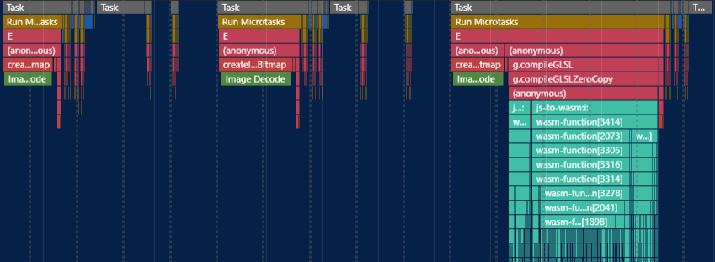
Limitations
Live Demo (Use Chrome/Edge Canary): https://gltf-webgpu.netlify.app/
Slow load time for large data sets
However, it works fine for small data sets in extension scenes such as Dragon Attenuation and Sheen Cloth
GLSL to SPIV-V takes time!
Notes:
So are there any downsides to using GLSL?

Slide 8
Roadmap
Live Demo (Use Chrome/Edge Canary): https://gltf-webgpu.netlify.app/
Improve load time for large data sets
Use WGSL for large data sets with less complex shader code (more verbose, better performance)
Use GLSL for small data sets with more complex
shader code (less verbose, easy to work with)
Support for more extensions: start with KHR_materials_sheen
Support for animation and skin

Slide 9
Acknowledgements
Live Demo (Use Chrome/Edge Canary): https://gltf-webgpu.netlify.app/
Thank you to all the authors below for making this project possible.
KhronosGroup/glTF-Sample-Viewer for providing a wonderful place to study glTF renderer. Importantly, the shader source codes are derived from this project.
glTF-Transform by Don McCurdy for providing an easy-to-use SDK for loading and reading glTF files.
kainino0x/glslang for providing a way to use GLSL shaders in WebGPU.
mikolalysenko/3d-view-controls for providing a user-friendly camera system.
Practical WebGPU Graphics by Jack Xu, PhD for introducing me to the world of WebGPU and providing the base code for this project.
The Complete JavaScript Course 2022: From Zero to Expert! by Jonas Schmedtmann for teaching me what "async/await" means and the fundamental of Javascript. Highly recommend this course!
Understanding TypeScript - 2022 Edition by Maximilian Schwarzmüller for teaching me those finer details about Typescript.
(Charles) Zixin Zhang
zixinzha@seas.upenn.edu
https://github.com/zixin96

Slide 10
Components
Live Demo (Use Chrome/Edge Canary): https://gltf-webgpu.netlify.app/
gl-Transform by Don McCurdy
JavaScript Library for reading 3D models in glTF 2.0 format
@webgpu/glslang by Kai Ninomiya
GLSL-to-SPIR-V compiler so that we can use GLSL in WebGPU
3d-view-controls by Mikola Lysenko
An easy-to-use 3D camera providing ViewProjection matrices
WebGPU Renderer + Shaders

Slide 11
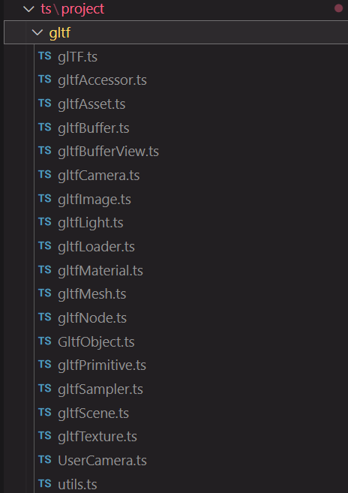
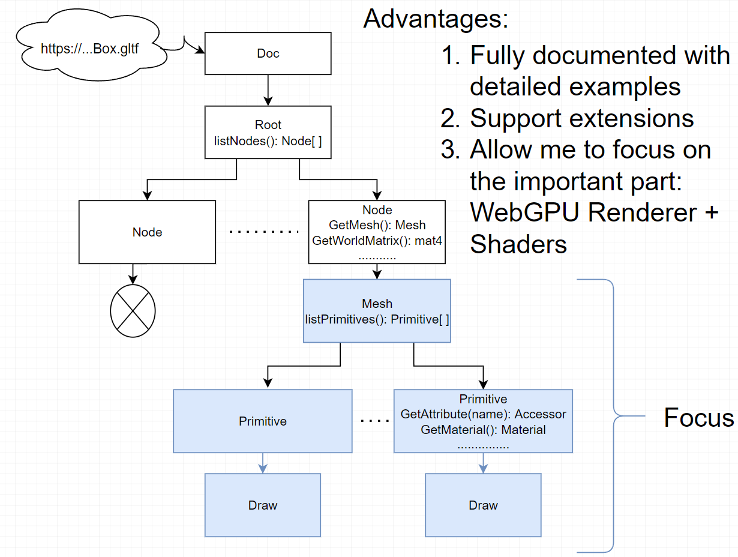
Architecture
Live Demo (Use Chrome/Edge Canary): https://gltf-webgpu.netlify.app/
Implement glTF loader from scratch:
Use gl-Transform:
“Don’t reinvent the wheel”
Notes:
Bad from scratch:
Successfully loads a MR box, however, going from box to texturedBox seems easy, but exactly very difficult, since it requires modifying/adding many files. It is complex, and will get even harder when we have more complex models. It’s error-prone and time-consuming. I want to spend more time on renderer and shaders, rather than on the gltf files. This is why I decide to search for a library.
Disadvantage of gl-transform:
dependency. Code tied to gl-Transform, but the author actively maintains the lib, last commit is 12/10

Slide 12
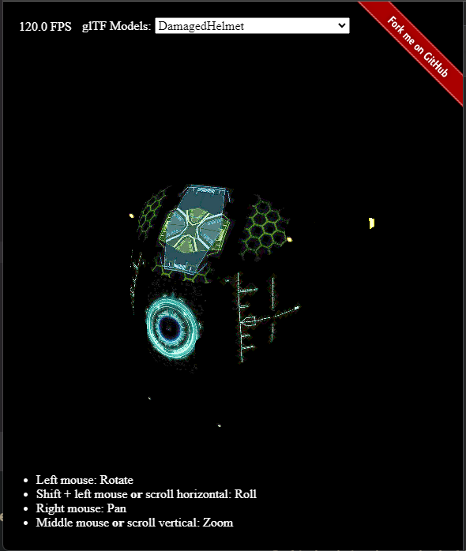
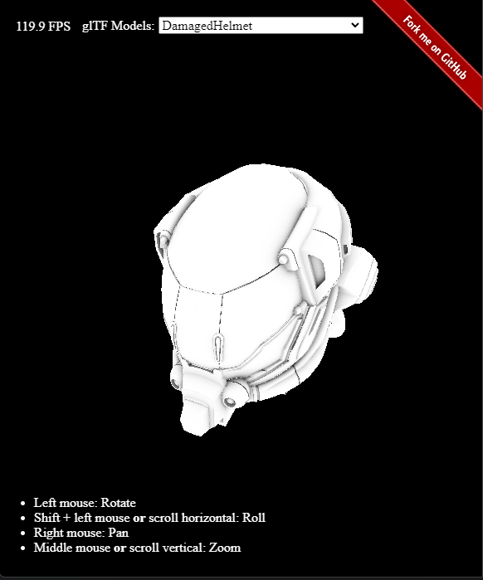
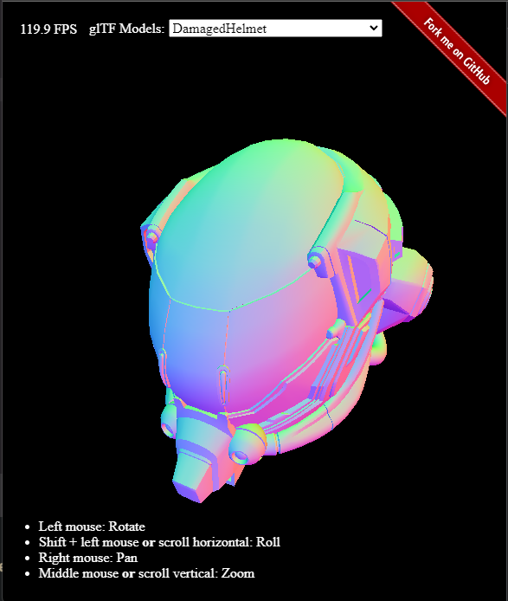
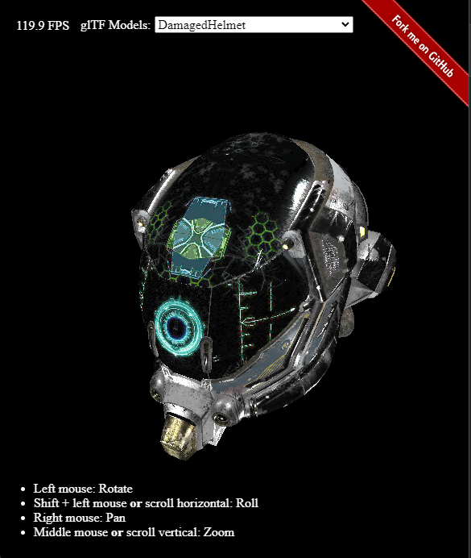
Motivations
Live Demo (Use Chrome/Edge Canary): https://gltf-webgpu.netlify.app/
Explore a new, low-level Graphics API (WebGPU) and a fast, efficient 3D transmission format (glTF 2.0)
Contribute to glTF and WebGPU’s open-source community
Create a fun, challenging, and rewarding project
+
+
+… =
Emissive
Occlusion
Normal Geometry
Goal

Slide 13
Live Demo (Use Chrome/Edge Canary): https://gltf-webgpu.netlify.app/
WGSL:
Higher Complexity
GLSL:
WGSL
GLSL
GLSL (WebGL)
Conversion is doable
Conversion is nontrivial
GLSL (WebGL):
Notes:
By doable: Do not need to modify the renderer code if you switch from GLSL to WGSL. All modifications are done in shaders

Slide 14
WGSL vs GLSL vs GLSL (WebGL)
Live Demo (Use Chrome/Edge Canary): https://gltf-webgpu.netlify.app/
Higher Complexity
WGSL:
GLSL:
Similarities
GLSL (WebGL):
Notes:
At first glance, WGSL is more complex. As you observe more, you can see some similarities between WGSL and GLSL as well (use binding and set). This brings us to next slide: why I use GLSL

